Slide 1
Machine Learning with Python

Slide 2
Agenda
Introduction to Machine Learning
Python {rpgramming
Supervised Learning – Classification and Regression
Unsupervised Learning – Clustering
Deep Learning using Nueral networks
Frameworks that make ML easy

Slide 3
Introduction to Machine Learning

Slide 4
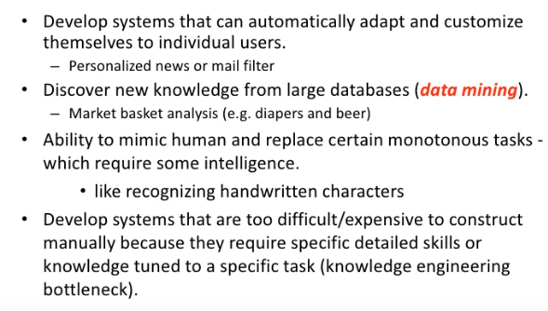
Why machine Learning

Slide 5
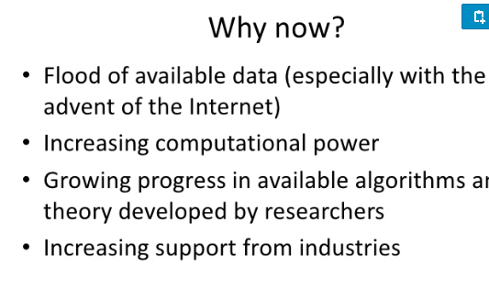
Why now?

Slide 6
Some sample applications
Amazon product recommendations
Siri, Google Now
Text to speech, translations
Image recognition
Chatbots

Slide 7
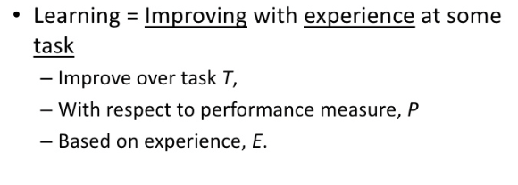
How does a machine learn

Slide 8
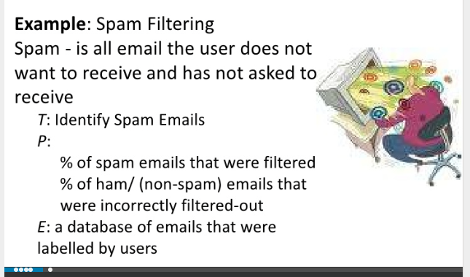
Simple Machine Learning Example

Slide 9
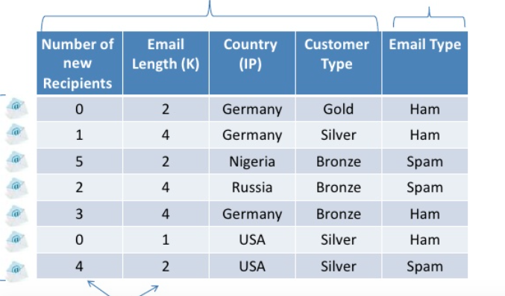
Preprocess data

Slide 10
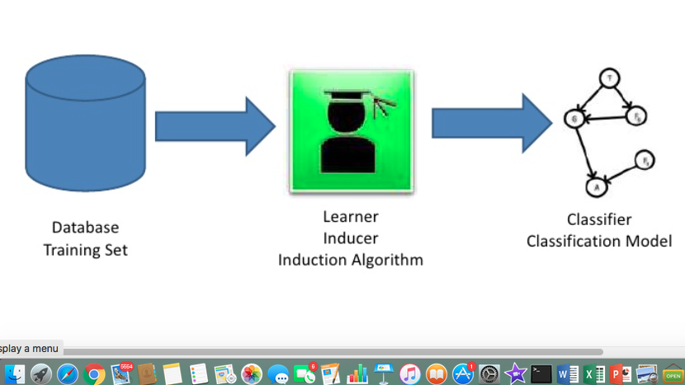
Learning Model Training

Slide 11
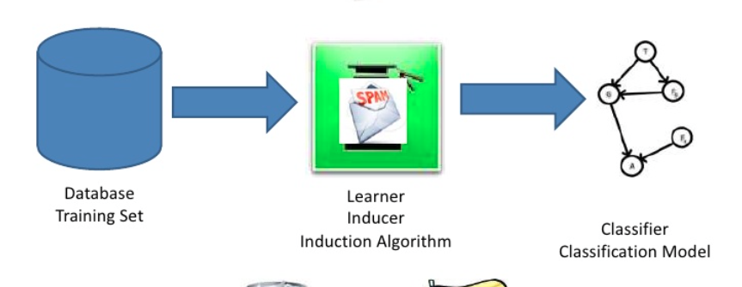
Test the Model

Slide 12
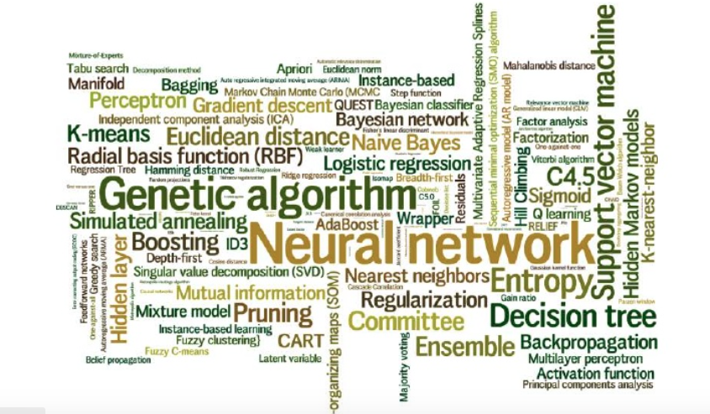
Learning ALgorithms

Slide 13
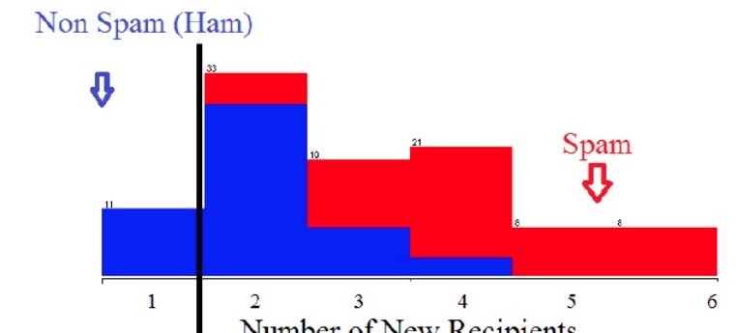
Spam Classifier

Slide 14
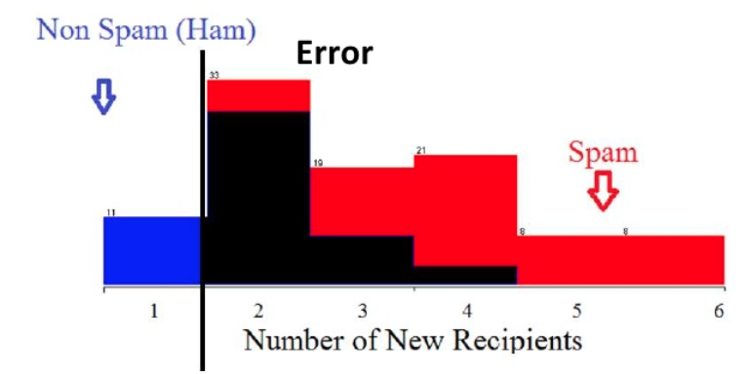
Spam CLassifier

Slide 15
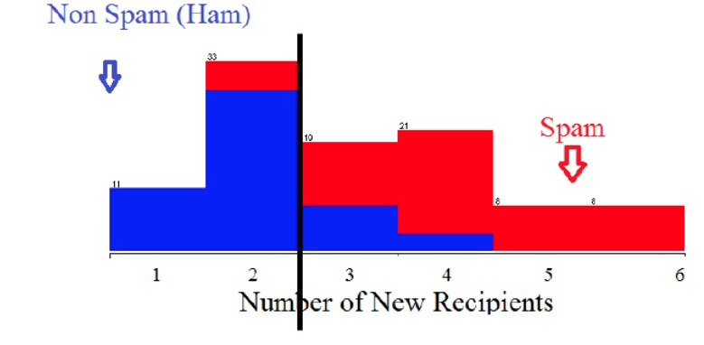
Spam Classifier

Slide 16
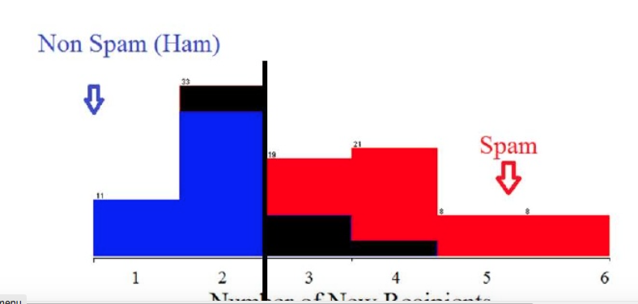
Spam Classifier

Slide 17
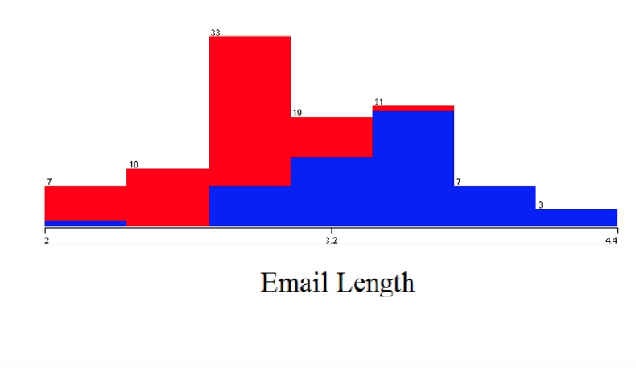

Slide 18
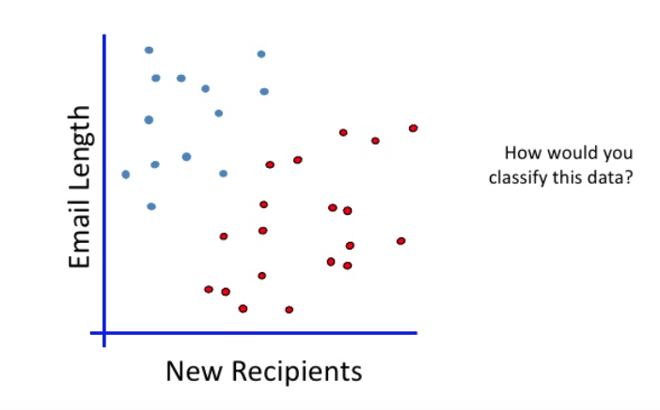
Linear Classifier

Slide 19
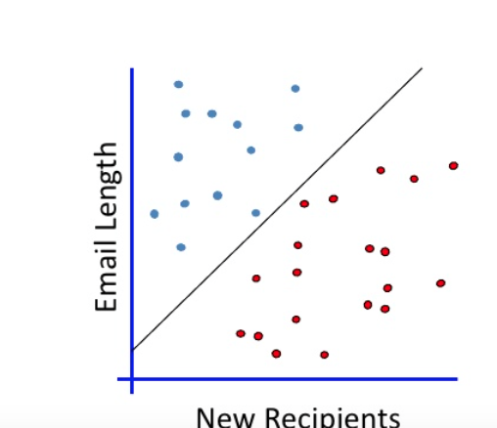
Best Fit line

Slide 20
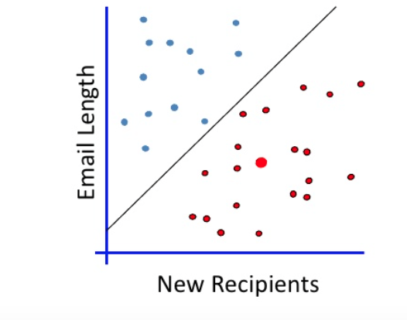
When a new email is sent

Slide 21
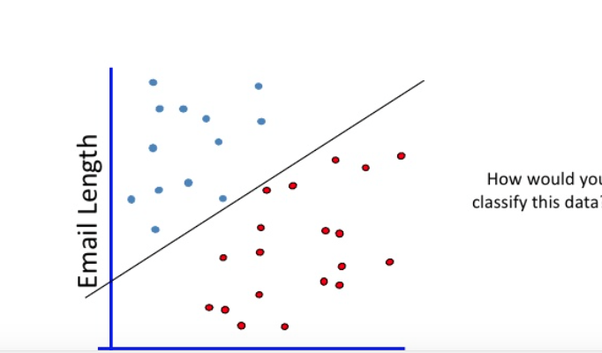
Whuch us the right line?

Slide 22
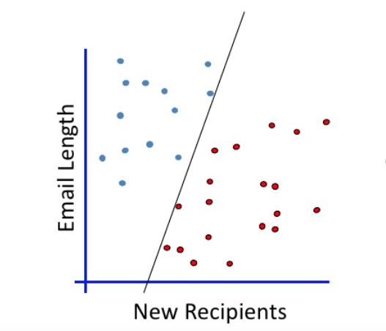
Which is the right line?

Slide 23
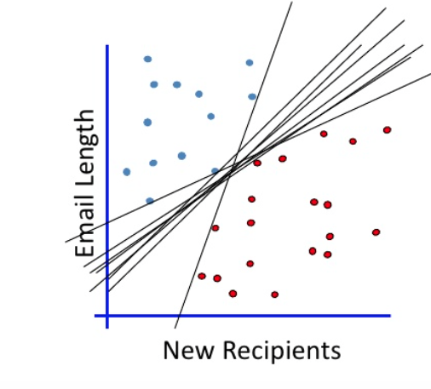
Whuch us the right line?

Slide 24
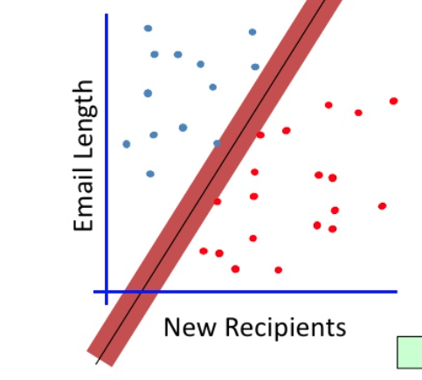
Maximum Margin

Slide 25
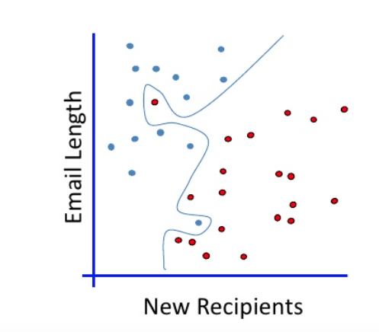
No Linear Classifier fits this

Slide 26
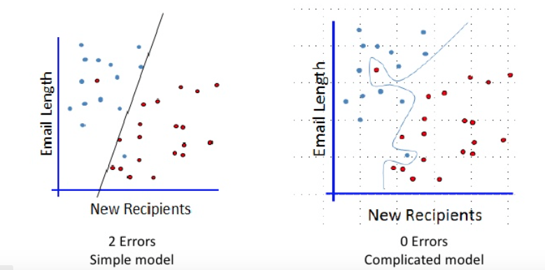
Which one?

Slide 27
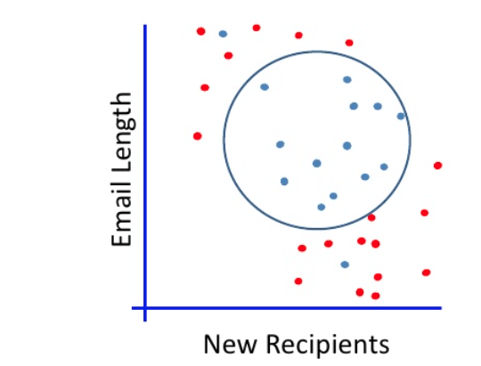
Non Linear Seperation

Slide 28
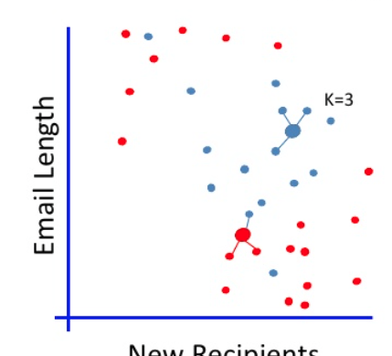
K-Nearest Neighbors

Slide 29
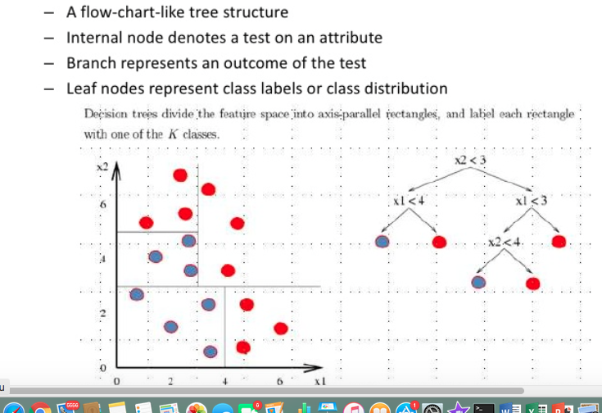
Decision Trees

Slide 30
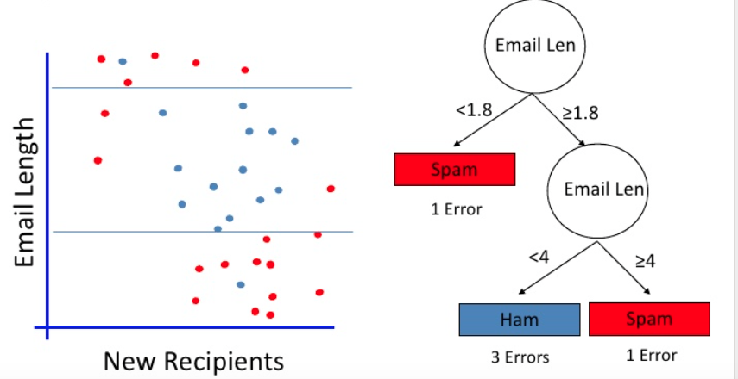
Sample Decision Tree

Slide 31
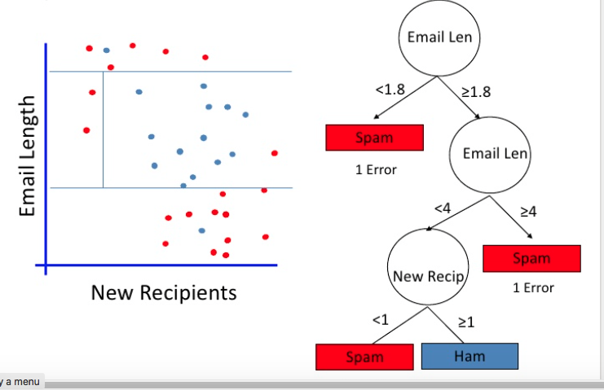
Decision tree with multiple constraints

Slide 32
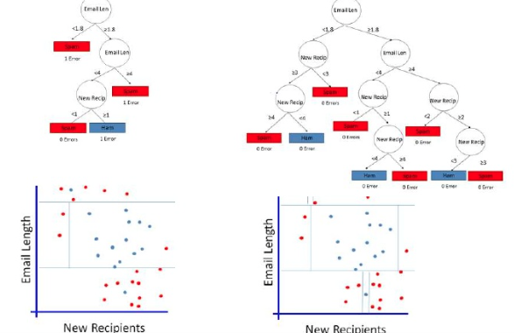
Which one?

Slide 33
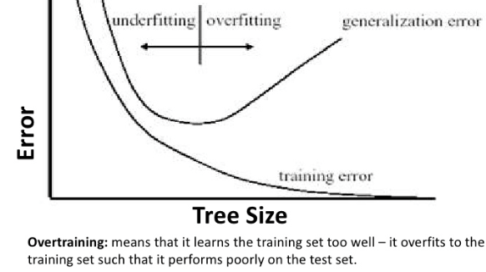
Overfitting and under fitting

Slide 34
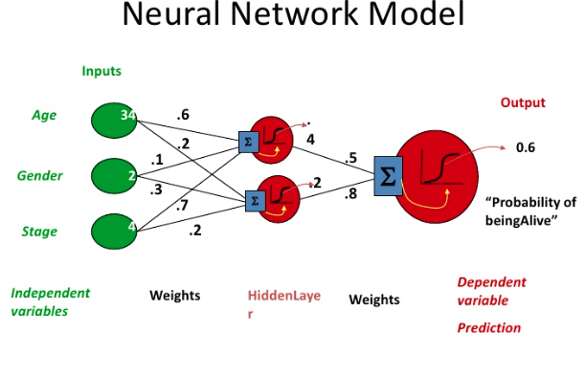
Nueral Networks

Slide 35
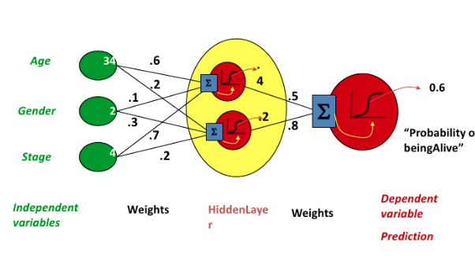
Probabilistic models

Slide 36
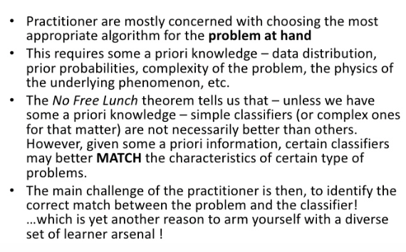
Why new Algorithms

Slide 37
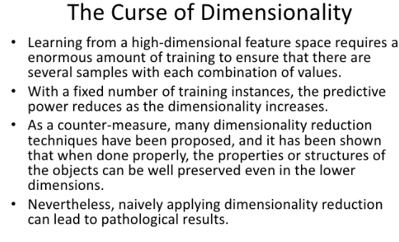
Less is More

Slide 38
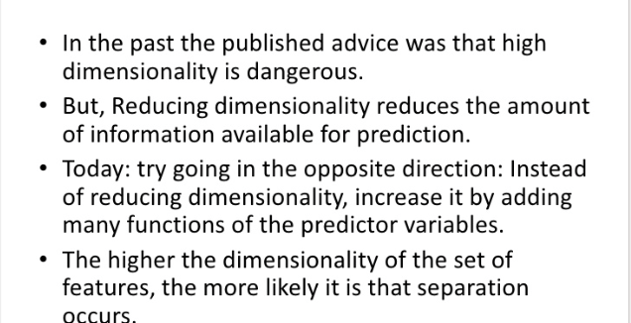
Less is More – Not Any more

Slide 39
Python Numpy

Slide 40
Numpy – What is it?
A library to play with multi-dimensional arrays
It is Numerical Python
Numpy and Mathplotlib go hand in glove
This is a open source library

Slide 41
Installing ML libraries using conda
https://www.davidculley.com/installing-python-on-a-mac/
https://conda.io/docs/user-guide/install/windows.html

Slide 42
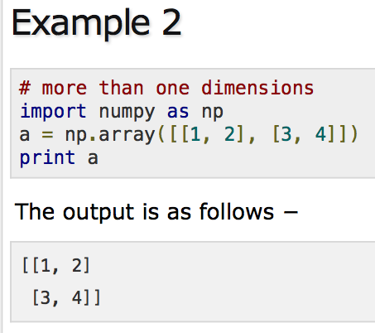
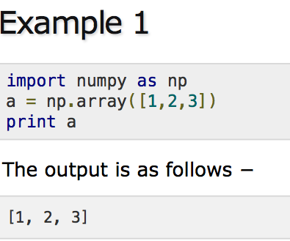
Numoy Examples

Slide 43
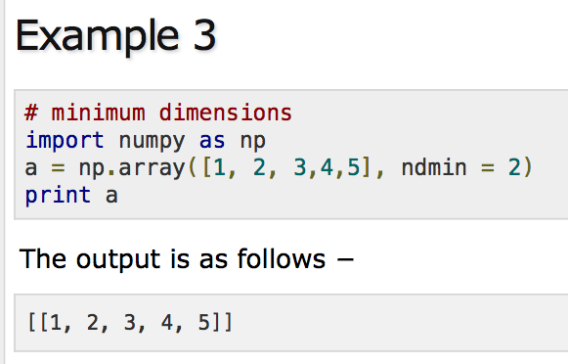
Numpy Examples

Slide 44
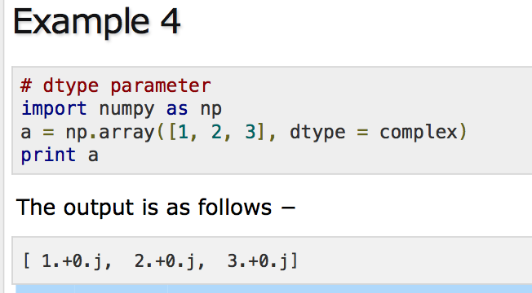
Numpy Examples

Slide 45
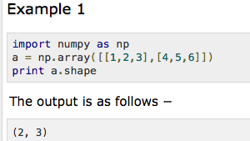
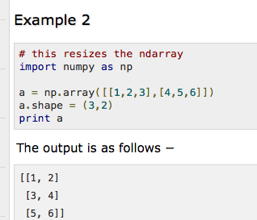
Numpy Arrays

Slide 46
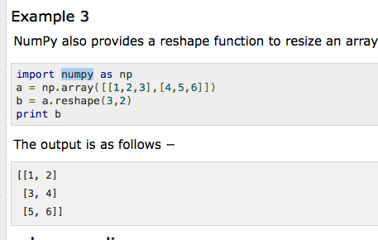
Numpy Arrays and examples

Slide 47
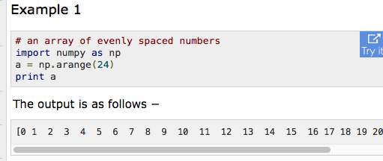
Numpy Arrays

Slide 48
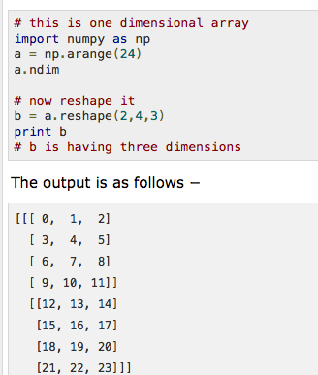
Numpy Arrays wirg multiple dimensions

Slide 49
For More Examples on Numpy
https://www.tutorialspoint.com/numpy/numpy_array_from_existing_data.htm

Slide 50
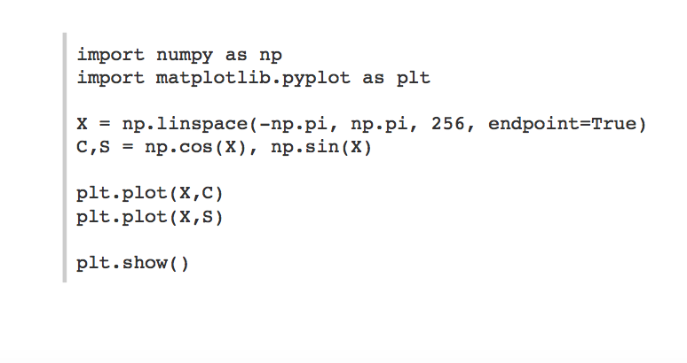
Using Mathplot libraries - sample

Slide 51
More on Mathplotlib
https://www.labri.fr/perso/nrougier/teaching/matplotlib/

Slide 52
Other libraries and software that are important
Jupyter notebook
Pandas for data processing

Slide 53
Linear Regression

Slide 54
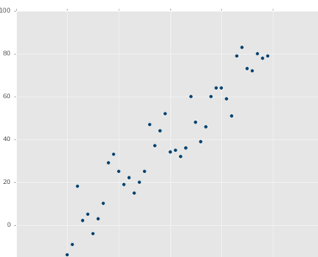
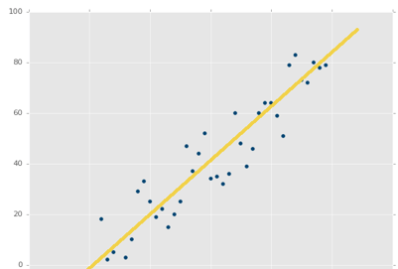
Sample data

Slide 55
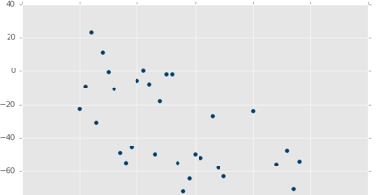
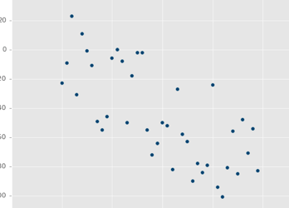
Sample data

Slide 56
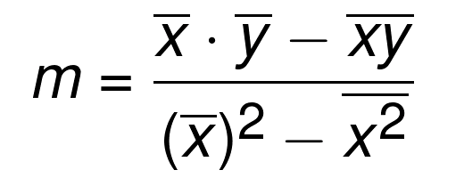
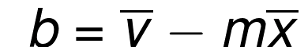
Linear Algebra

Slide 57

Squared Error

Slide 58

Coefficient of determination

Slide 59

Low Variance and Positive Correlation

Slide 60

Low Variance and Negative Correlation

Slide 61
K – Nearest Neighbors

Slide 62

Sample dataset

Slide 63

Classify this point

Slide 64

Classify this point

Slide 65

Mearest Neighbor Algorithm (k = 3)

Slide 66

Euclidean Distance

Slide 67
Final thoughts on k-Nearest neighbors
Accuracy is not the key but speed is
Use nJobs in scikit learn to speed up
Confidence is important but do not ignore voting percentages

Slide 68
Support Vector Machines (SVM)

Slide 69
Overview
Developed by Vladimir Vapnik in 1960s
Find the best fitting boundary – Line in 2D space and hyperplane in 3D space
Find the widest seperating hyperplane from support vectors

Slide 70

Support Vectors

Slide 71

Find the Support Vectors

Slide 72

Identifying Support Vectors

Slide 73

Decision Boundary

Slide 74

Decision Boundary found

Slide 75

Data - Not linearly seperable

Slide 76
Vector Basics

Slide 77

Vector has magnitude and direction

Slide 78

Magnitude of a vector

Slide 79

Vector Dot Product

Slide 80

Support Vector Decision Boundary

Slide 81

In the vector space for more than 2-D

Slide 82

Hyperplane, positive and negative support vectors

Slide 83

Optimization Problem

Slide 84



Width between hyperplanes

Slide 85


Lagrange Constraint oprimization

Slide 86


Minimum of convex function

Slide 87



Polynomial Kernels for linearly inseperable data

Slide 88
K-Means Clustering

Slide 89

Sample Dataset

Slide 90
Find the centroid
Choose value for K
Randomly select K featuresets to start as your centroids
Calculate distance of all other featuresets to centroids
Classify other featuresets as same as closest centroid
Take mean of each class (mean of all featuresets by class), making that mean the new centroid
Repeat steps 3-5 until optimized (centroids no longer moving)

Slide 91

Finding centroids

Slide 92

K-Means Output

Slide 93
Hierarchical clustering

Slide 94
Find Cluster Center
Every feature set is a cluster center
Scientist provides radius or bandwidth
Find the mean of the points in the bandwidth and make it new cluster center
Find points inside the bandwidth from the new centroid
Wait for convergence

Slide 95
Artificial Nueral Networks

Slide 96


Nueral Network - Sample

Slide 97

Nueral network = Example

Slide 98

Simple Neural Network

Slide 99

Error Function

Slide 100
Where do we get large datasets
Wprd Net
Image Net
Wikipedia
Common Crawl

Slide 101
Frameoworks for Nueral Networks
Tensor Flow
Thino
Torch

Slide 102
Install Tensor Flow
For CPU version
Pip install tensorflow
For GPU version
Installing GPU TensorFlow on Linux
Installing GPU TensorFlow on Windows

Slide 103
What is Tensor Flow
Massive Array Minupulation Library
Used for Number crunching
Makes array manipulations easy in distributed environments

Slide 104
What is a tensor?
An array
A matrix
Helps computation graph be created
Distribute matrix multiplications and array manipulayions

Slide 105
MNST Prediction
28*28 pixel images of numbers
784 pixels

Slide 106
How does nueral network works
Take input data and send to input layer
Use this with activation layer
Find the cost function and lower the error
Learn weights, bias using learning rate by feeding forward and applying back propogation

Slide 107
Recurring Neural networks
Order matters
Arun drove a car
Car drove arun

Slide 108

Recurring Nueral network

Slide 109

Long Short Term Memory

Slide 110

Covolution Nueral network

Slide 111

Convolution Nueral network

Slide 112

Feature map

Slide 113

Feature Map

Slide 114

Max Pooling

Slide 115

After Pooling

